Slide 1
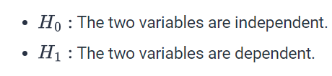
The chi-square test of independence is for data that can be organized into a contingency table. A contingency table records the frequency of observations described by two categorical variables. The test can examine the presence of dependence between the two variables.

Slide 2
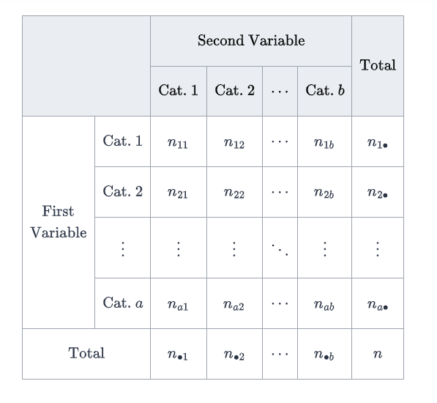

Slide 3
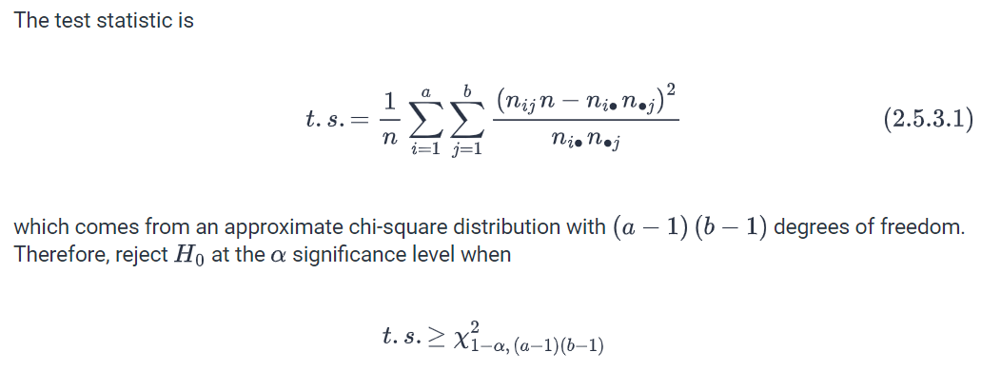

Slide 4
EXAMPLE

Slide 5
